Slide 1

DATA ANALYTICS & BUSINESS INTELLIGENCE

Slide 2
BRIDGING THE GAP BETWEEN MANAGEMENT & TECHNOLOGY

Slide 3
DATA ANALYTICS AND BUSINESS INTELLIGENCE

Slide 4
COURSES
Module 1: Foundation of Data Analytics & Python Programming
Module 2: Probability & Statistics
Module 3: Data Munging with Python
Module 4: Machine learning – Part 1
Module 5: Machine learning – Part 2
Module 6: Optimization in Analytics
Module 7: Introduction to SQL and Business Intelligence

Slide 5
MODULE PROBABILITY & STATISTICS
Descriptive Analytics: Describing and summarizing data sets, measures of central tendency, dispersion, skewness, kurtosis, Correlation.
Probability: Measures of probability, conditional probability, independent event, Bayes’ theorem, random variable, discrete (binomial, Poisson, geometric, hypergeometric, negative binomial) and continuous (uniform, exponential, normal, gamma). Expectation and variance, markov inequality, chebyshev’s inequality, central limit theorem.
Inferential Statistics: Sampling & Confidence Interval, Inference & Significance. Estimation and Hypothesis Testing, Goodness of fit, Test of Independence, Permutations and Randomization Test, ttest/z-test (one sample, independent, paired), ANOVA, chi-square.

Slide 6
REFERENCES
Business Analytics : JAMES EVANS
Statistics for Business : STINE AND FOSTER
Introduction to Probability Models : Sheldon Ross
An Introduction to Statistical Learning with Applications in R : Gareth James, Daniela Witten, Trevor Hastie, Robert Tibshirani
Business Analytics – The Science of Data – Driven Decision Making : U. Dinesh Kumar, Wiley

Slide 7
STRUCTURE OF MY PRESENTATION:
BASIC PROBABILITY
1. Introduction to Data Analytics in context of Probability and Statistics
2. Data to Probability
3. Measure of Probability
4. Algebra of Events
5. Joint & Marginal Probability
6. Conditional Probability
7. Independent Events
8. Baye’s Theorem
9. Application of Baye’s Theorem

Slide 8
RANDOM VARIABLES AND MEASURES
i. Discrete Random Variables
1. Bernoulli Distribution
2. Binomial Distribution
3. Poisson Distribution
4. Geometric Distribution
5. Hypergeometric Distribution
6. Negative Binomial Distribution
ii. Continuous Random variables
1. Uniform Distribution
2. Exponential Distribution
3. Normal Distribution
4. Gamma Distribution

Slide 9
INEQUALITIES & THEOREM
1. Markov Inequality
2. Chebysher’s Inequality
3. Central Limit Theorem
Miscellaneous

Slide 10
DATA ANALYTICS
Analytics is the use of:
Data,
Information technology,
Statistical analysis,
Quantitative methods, and
Mathematical or computer-based models
to help managers gain improved insight about their business operations and make better, fact-based decisions.

Slide 11
Examples of Applications
Pricing
setting prices for consumer and industrial goods, government contracts, and maintenance contracts
Customer segmentation
identifying and targeting key customer groups in retail, insurance, and credit card industries
Merchandising
determining brands to buy, quantities, and allocations
Location
finding the best location for bank branches and ATMs, or where to service industrial equipment
Social Media
understand trends and customer perceptions; assist marketing managers and product designers

Slide 12
Evolution of Business Analytics
Business intelligence
Information Systems
Statistics
Operations research/Management science
Decision support systems

Slide 13
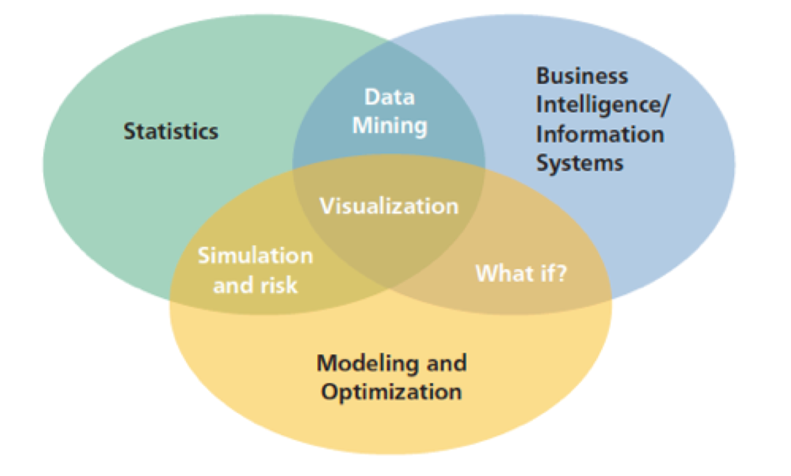
A Visual Perspective of Data Analytics

Slide 14
Impacts and Challenges
Benefits
…reduced costs, better risk management, faster decisions, better productivity and enhanced bottom-line performance such as profitability and customer satisfaction.
Challenges
…lack of understanding of how to use analytics, competing business priorities, insufficient analytical skills, difficulty in getting good data and sharing information, and not understanding the benefits versus perceived costs of analytics studies.

Slide 15
Phases of Analytics :
Descriptive analytics: the use of data to understand past and current business performance and make informed decisions
Diagnostic analytics: focus on past performance to determine what happened and why. Takes a deeper look at data to understand the root causes of events.
Predictive analytics: predict the future by examining historical data, detecting patterns or relationships in these data, and then extrapolating these relationships forward in time.
Prescriptive analytics: identify the best alternatives to minimize or maximize some objective

Slide 16
Tools
Database queries and analysis
Dashboards to report key performance measures
Data visualization
Statistical methods
Spreadsheets and predictive models
Scenario and “what-if” analyses
Simulation
Forecasting
Data and text mining
Optimization
Social media, web, and text analytics

Slide 17
Data for Business Analytics
Data: numerical or textual facts and figures that are collected through some type of measurement process.
Information: result of analyzing data; that is, extracting meaning from data to support evaluation and decision making.

Slide 18
Examples of Data Sources and Uses
Annual reports
Accounting audits
Financial profitability analysis
Economic trends
Marketing research
Operations management performance
Human resource measurements
Web behavior
page views, visitor’s country, time of view, length of time, origin and destination paths, products they searched for and viewed, products purchased, what reviews they read, and many others.

Slide 19
Big Data
Big data to refer to massive amounts of business data from a wide variety of sources, much of which is available in real time, and much of which is uncertain or unpredictable. IBM calls these characteristics volume, variety, velocity, and veracity.
“The effective use of big data has the potential to transform economies, delivering a new wave of productivity growth and consumer surplus. Using big data will become a key basis of competition for existing companies, and will create new competitors who are able to attract employees that have the critical skills for a big data world.” - McKinsey Global Institute, 2011

Slide 20
Measurement Scales
Categorical (nominal) data - sorted into categories according to specified characteristics.
Ordinal data - can be ordered or ranked according to some relationship to one another.
Interval data - ordinal but have constant differences between observations and have arbitrary zero points.
Ratio data - continuous and have a natural zero.

Slide 21
Data Tables
Some Basic Ideas
Data are a collection of numbers, labels, or symbols with context
A data table is a rectangular arrangement of data with rows and columns
Observations or cases form the rows; common attributes or variables form the columns

Slide 22
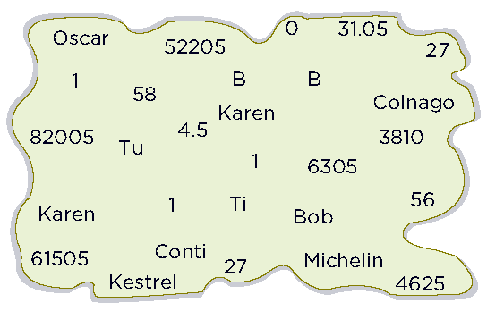
Data Tables
Disorganized Data

Slide 23
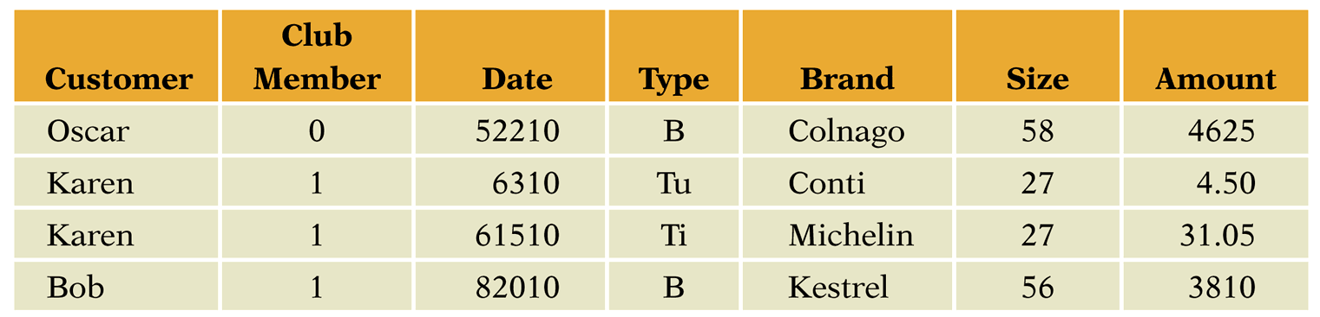
Data Tables
Same Data in a Data Table

Slide 24
Data Tables
Organize data to yield meaningful information
Provide context(e.g. who, what, when)
Improve interpretability with meaningful names, formatting and units

Slide 25
From Data to Probability
In a call center, what is the probability that an
agent answers an easy call?
An easy call can be handled by a first-tier agent; a hard call needs further assistance
Two possible outcomes: easy and hard calls
Are they equally likely?

Slide 26
From Data to Probability(contd.)
Probability = Long Run Relative Frequency
Keep track of calls (1 = easy call; 0 = hard call)
Graph the accumulated relative frequency of easy calls
In the long run, the accumulated relative frequency converges to a constant (probability)

Slide 27
From Data to Probability(contd.)
The Law of Large Numbers (LLN)
The relative frequency of an outcome
converges to a number, the probability of the
outcome, as the number of observed
outcomes increases.
Notes: The pattern must converge for LLN to apply. LLN only applies in the long run.

Slide 28
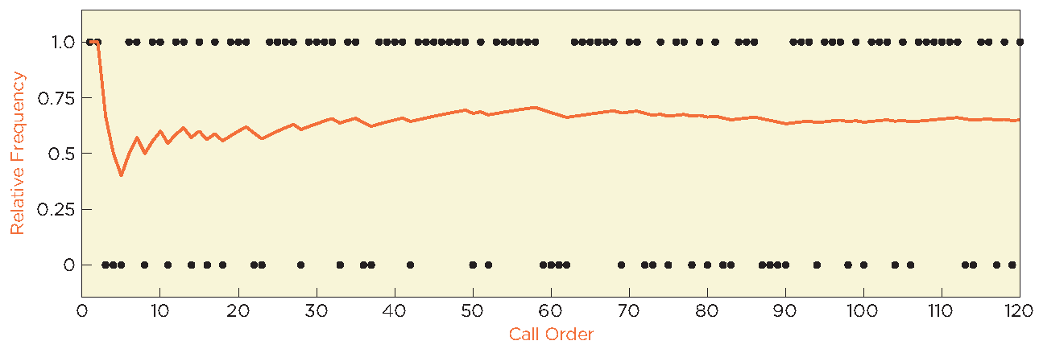
From Data to Probability(contd.)
The Accumulated Relative Frequency of
Easy Calls Converges to 70%

Slide 29
Basic Concepts of Probability
Probability is the likelihood that an outcome occurs.
An experiment is the process that results in an outcome.
The outcome of an experiment is a result that we observe.
The sample space is the collection of all possible outcomes of an experiment.
Denoted by S; S = {easy, hard}
Subsets of samples spaces are events; denoted as A, B, etc.

Slide 30
MEASURE OF PROBABILITY

Slide 31
Definitions of Probability
Probabilities may be defined from one of three perspectives:
Classical definition: probabilities can be deduced from theoretical arguments
Relative frequency definition: probabilities are based on empirical data

Slide 32
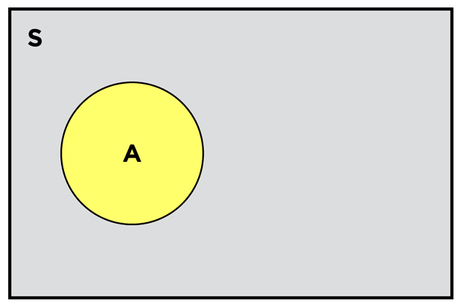
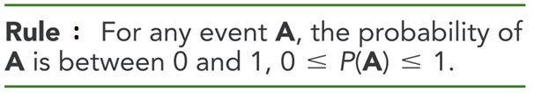
Rules of Probability

Slide 33
Some Definitions(contd.) :
Venn Diagrams
The probability of an event A is denoted as P(A).
Venn diagrams are graphs for depicting the relationships among events

Slide 34


Rules of Probability

Slide 35
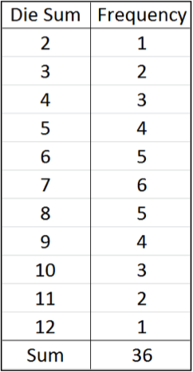
Example : Classical Definition of Probability
Roll 2 dice
36 possible rolls (1,1), (1,2),…(6,5), (6,6)
Probability = number of ways of rolling a number divided by 35;
e.g., probability of a 3 is 2/36
Suppose two consumers try a new product.
Four outcomes:
1. like, like
2. like, dislike
3. dislike, like
4. dislike, dislike
Probability at least one dislikes product = 3/4

Slide 36
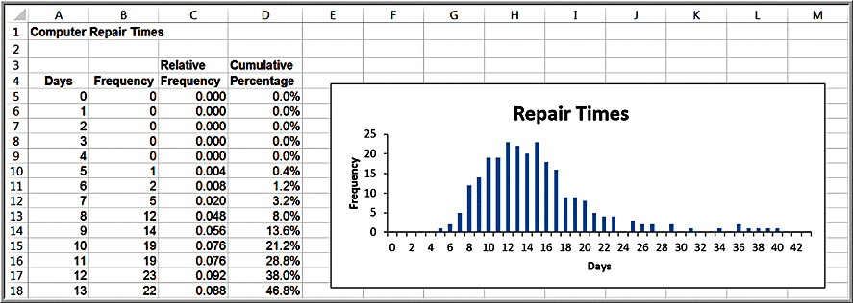
Example : Relative Frequency Definition of Probability
Use relative frequencies as probabilities
Probability a computer is repaired in 10 days = 0.076

Slide 37
Algebra of Events

Slide 38
Rules of Probability(contd.)
Rule : Addition Rule for Disjoint Events
Disjoint events are mutually exclusive;
i.e., they have no outcomes in common.
The union of two events is the collection of outcomes in A, in B, or in both (A or B)

Slide 39
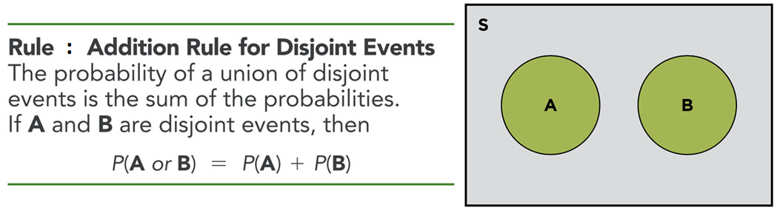
Rules of Probability

Slide 40
Rules of Probability(contd.)
Rule : Addition Rule for Disjoint Events
Extends to more than two events
P (E₁ or E₂ or … or E_{k}) =
P(E₁) + P(E₂) + … + P(E_{k})

Slide 41
Probability Rules and Formulas
Label the n outcomes in a sample space as O₁, O₂, …, O_{n}, where O_{i} represents the i^{th} outcome in the sample space. Let P(O_{i}) be the probability associated with the outcome O_{i}.
The probability associated with any outcome must be between 0 and 1.
0 ≤ P(O_{i}) ≤ 1 for each outcome O_{i}
The sum of the probabilities over all possible outcomes must be equal to 1.
P(O₁) + P(O₂) + … + P(O_{n}) = 1

Slide 42
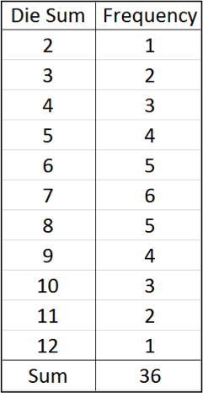
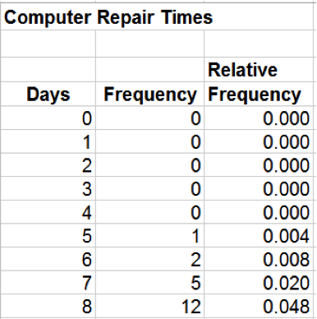
Example : Computing the Probability of an Event
Consider the events:
Rolling 7 or 11 on two dice
Probability = 6/36 + 2/36 = 8/36.
Repair a computer in 7 days or less
Probability =
= O₁ + O₂ + O₃ + O₄ + O₅ + O₆ + O₇
= 0 + 0 + 0 + 0 + .004 + .008 + .020
= 0.032

Slide 43
Complement of an Event
If A is any event, the complement of A, denoted A^{c}, consists of all outcomes in the sample space not in A.
Rule : The probability of the complement of any event A is P(A^{c}) = 1 – P(A).

Slide 44
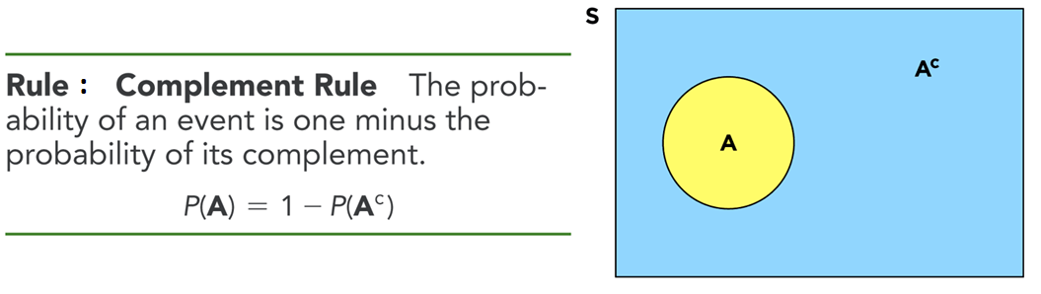
Rules for Probability(contd.)

Slide 45
Example : Computing the Probability of the Complement of an Event
Dice example:
A = {7, 11}
P(A) = 8/36
A^{c} = {2, 3, 4, 5, 6, 8, 9, 10, 12}
Using Rule :
P(A^{c}) = 1 − 8/36 = 28/36

Slide 46
Rules for Probability(contd.)
The intersection of A and B contains the outcomes in both
A and B
Denoted as A ∩ B read “A and B”

Slide 47
Example : Computing the Probability of Mutually Exclusive Events
Dice Example:
A = {7, 11}: P(A) = 8/36
B = {2, 3, 12}: P(B) = 4/36
P(A or B) = Union of events A and B
= P(A) + P(B)
= 8/36 + 4/36 = 12/36

Slide 48
Non-Mutually Exclusive Events
The notation (A and B) represents the intersection of events
A and B – that is, all outcomes belonging to both A and B .
Rule : If two events A and B are not mutually exclusive, then
P(A or B) = P(A)+ P(B) - P(A and B).

Slide 49
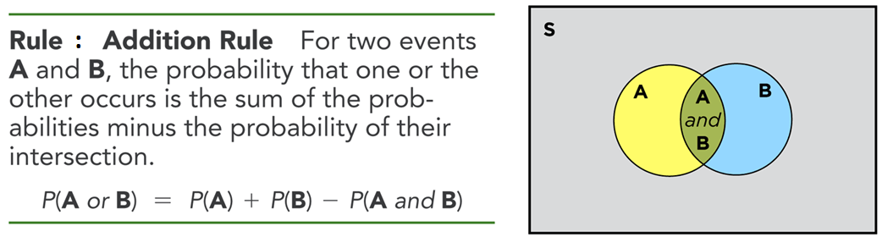
Rules for Probability(contd.)

Slide 50
Example : Computing the Probability of Non – Mutually Exclusive Events
Dice Example:
A = {2, 3, 12}: P(A) = 4/36
B = {even number}: P(B) = 18/36
(A and B) = {2, 12}: P(A and B) = 2/36
P(A or B) = P(A) + P(B) – P(A and B)
= 4/36 + 18/36 – 2/36
= 20/36

Slide 51
JOINT & MARGINAL PROBABILITY

Slide 52
Joint and Marginal Probability
The probability of the intersection of two events is
called a joint probability.
The probability of an event, irrespective of the
outcome of the other joint event, is called a
marginal probability.

Slide 53
Application of Joint and Marginal Probability
A sample of 100 individuals were asked to evaluate their preference for three new proposed energy drinks in a blind taste test.
The sample space consists of two types of outcomes corresponding to each individual: gender (F = female or M = male) and brand preference (B₁, B₂, or B₃).
Define a new sample space consisting of the outcomes that reflect the different combinations of outcomes from these two sample spaces.
O₁ = the respondent is female and prefers brand 1
O₂ = the respondent is female and prefers brand 2
O₃ = the respondent is female and prefers brand 3
O₄ = the respondent is male and prefers brand 1
O₅ = the respondent is male and prefers brand 2
O₆ = the respondent is male and prefers brand 3
The probability of each of these events is the intersection of the gender and brand preference event. For example, P(O₁) = P(F and B₁)

Slide 54
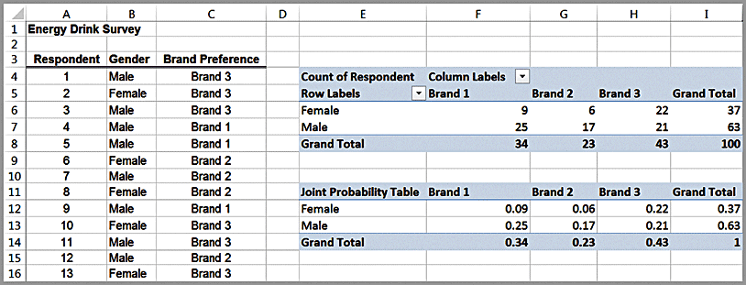
Example : Applying Probability Rules to Joint Events
Energy Drink Survey
The joint probabilities of gender and brand preference are calculated by dividing the number of respondents corresponding to each of the six outcomes listed above by the total number of respondents, 100.
E.g., P(F and B₁) = P(O₁) = 9/100 = 0.09
Joint probabilities

Slide 55
Example (contd.)
The marginal probabilities for gender and brand preference are calculated by adding the joint probabilities across the rows and columns
E.g., the event F, (respondent is female) is comprised of the outcomes O₁, O₂, and O₃, and therefore P(F) = P(F and B₁) + P(F and B₂) + P(F and B₃) = 0.37
Marginal probabilities

Slide 56
Joint/Marginal Probability Rule
Calculations of marginal probabilities leads to the following probability rule:
Rule : If event A is comprised of the outcomes {A₁, A₂, …, A_{n}} and event B is
comprised of the outcomes {B₁, B₂, …, B_{n}}, then
P(A_{i}) = P(A_{i} and B₁) + P(A_{i} and B₂) + … + P(A_{i} and B_{n})

Slide 57
Example (contd.)
Events F and M are mutually exclusive, as are events B₁, B₂, and B₃ since a respondent may be only male or female and prefer exactly one of the three brands. We can use Rule 3 to find, for example, P(B₁ or B₂) = 0.34 + 0.23 = 0.57.
Events F and B₁, however, are not mutually exclusive because a respondent can be both female and prefer brand 1. Therefore, using Rule 4, we have P(F or B₁) = P(F) + P(B₁) – P(F and B₁) = 0.37 + 0.34 – 0.09 = 0.62.

Slide 58
Conditional Probability
Conditional probability is the probability of occurrence of
one event A, given that another event B is known to be
true or has already occurred.

Slide 59
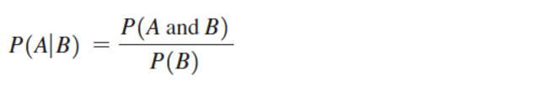
Conditional Probability Formula
The conditional probability of an event A given that event B is
known to have occurred is
We read the notation P(A|B) as “the probability of A given B.”

Slide 60
Example
A family has two children. What is the conditional probability that both are boys given that at least one of them is a boy?

Slide 61
Ans.
Let A be the event such that both are boys
A = {bb}
Let B be the event such that at least one of them is a boy
B = {bg, gb, bb}
P(B) = 3/4
(A and B) = {bb}
P(A and B) = 1/4
P(A/B) = P(A and B) / P(B)
= (1/4)/(3/4)
= 1/3

Slide 62


Variations of the Conditional Probability Formula
P(A and B) = P(A | B) P(B)
P(B and A) = P(B | A) P(A)
Note: P(A and B) = P(B and A)
Multiplication law of probability:

Slide 63
Extension of the Multiplication Law
Suppose B₁, B₂, . . . , B_{n} are mutually exclusive events
whose union comprises the entire sample space. Then

Slide 64
Example
Suppose that each of the three men at a party throws his hat into the centre of the room. The hats are first mixed up and then each man randomly selects a hat. What is the probability that none of the three men selects his own hat?

Slide 65
Ans.
Let E_{i} be the event such that i^{th} person will get his own hat
P(E₁E₂) = P(E₁) P(E₂/E₁)
= (1/3) (1/2) = 1/6
Similarly, P(E₂E₃) = 1/6 and P(E₁E₃) = 1/6
P(E₁E₂E₃) = P(E₁) P(E₂/E₁) P(E₃/E₁E₂)
= (1/3) (1/2) (1) = 1/6
Required probability = 1 – P(E₁ or E₂ or E₃)
= 1 – [P(E₁) + P(E₂) + P(E₃) – P(E₁E₂) – P(E₂E₃) – P(E₁E₃) + P(E₁E₂E₃) ]
= 1 – [ (1/3) + (1/3) + (1/3) – (1/6) – (1/6) – (1/6) + (1/6) ]
= 1/3

Slide 66
Example : Computing a Conditional Probability in a Cross-Tabulation
Suppose we know a respondent is male. What is the probability that he prefers Brand 1?
Using cross-tabulation: Of 63 males, 25 prefer Brand 1, so the probability of preferring Brand 1 given that a respondent is male = 25/63
Using joint probability table: divide the joint probability 0.25 (the probability that the respondent is male and prefers brand 1) by the marginal probability 0.63 (the probability that the respondent is male).

Slide 67
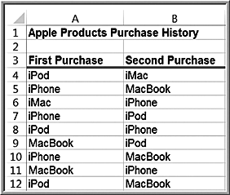
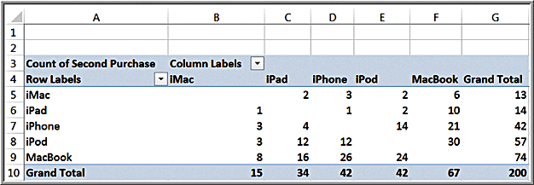
Example : Conditional Probability in Marketing
Apple Purchase History
The PivotTable shows the count of the
type of second purchase given that each
product was purchased first.
Probability of purchasing an iPad
given that a customer already purchased
an iMac = 2/13

Slide 68
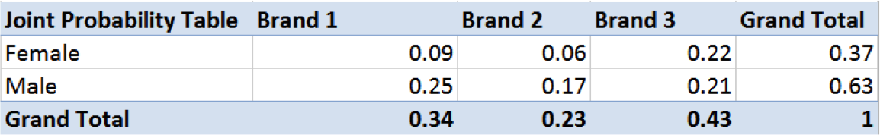
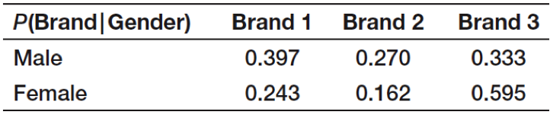
Example : Using the Conditional Probability Formula
P(B₁|M) = P(B₁ and M)/ P(M) = (0.25)/(0.63) = 0.397
P(B₁|F) = P(B₁ and F)/ P(F) = (0.09)/(0.37) = 0.243
Summary of conditional probabilities:
Applications in marketing and advertising.

Slide 69
Example : CONDITIONAL/JOINT/MARGINAL PROBABILITY : DIAGNOSTIC TESTING
Motivation
If a mammogram indicates that a 55 year old woman tests positive for breast cancer, what is the probability that she in fact has breast cancer?

Slide 70
Example : DIAGNOSTIC TESTING
Method
Past data indicates the following probabilities:
P(Test negative І No cancer) = 0.925
P(Test positive І Cancer) = 0.85
P(Cancer) = 0.005

Slide 71
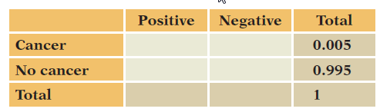
Example : DIAGNOSTIC TESTING(contd.)
Mechanics – Fill in the Probability Table

Slide 72
Example : DIAGNOSTIC TESTING(contd.)
Mechanics – Fill in the Probability Table
Use Multiplication Rule to obtain joint
probabilities
For example, P (Cancer and Test positive)
= P (Cancer) P(Test positive І Cancer)
= 0.005 0.85 = 0.00425

Slide 73
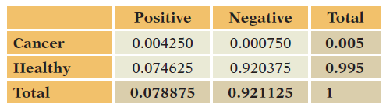
DIAGNOSTIC TESTING(contd.)
Mechanics – Completed Probability Table

Slide 74
DIAGNOSTIC TESTING(contd.)
Message
The chance that a woman who tests positive
actually has cancer is small, a bit more than 5%.

Slide 75
FRAUD DETECTION
Credit-card fraud costs business in the United States billions of dollars each year in stolen goods. Compounding the problem, the risk of fraud increases with the rapidly growing online retail market. To reduce fraud, businesses and credit card vendors have devised systems that recognize characteristics of fraudulent transactions. These systems are not perfect, however and sometimes flag honest transactions as fraudulent and sometimes miss fraudulent transactions.
A business has been offered a fraud detection system to protect its online retail site. The system promises very high accuracy. The system catches 99% of fraudulent transactions; that is, given a transaction is fraudulent, the system signals a problem 99% of the time. The system flags honest transactions as fraudulent only 1% of the time.

Slide 76
What would be possible consequences to the retailer of mistaking honest transactions for fraudulent transactions? Mistaking fraudulent transactions for honest transactions?

Slide 77
ANALYSIS
Mistaking honest for fraud risks annoying or embarrassing customers; missing fraud means losing merchandise.

Slide 78
The description of this system gives several conditional probabilities, but are these the conditional probabilities that are most relevant to owners of the retail size? What other probabilities would be helpful?

Slide 79
ANALYSIS
P(fraud/signal fraud) or P(honest/did not signal fraud)

Slide 80
c) Suppose that the prevalence of fraud among transactions at the retailer is 1%. What are the chances that the system incorrectly labels honest transactions as fraudulent?

Slide 81
 | +ve Signal (Fraudulent) | -ve Signal (Not Fraudulent)
FRAUD |  |  | 0.01
HONEST |  |  | 0.99
P[Fraud] = 0.01
P[Honest] = 0.99
P[+ ve signal/ Fraud] = 0.99
P[- ve signal/ Fraud] = 0.01
P[+ ve signal/ Honest] = 0.01
P[- ve signal/ Honest] = 0.99

Slide 82
Required probability = P[H/ +ve] = P[+ve/ H].P[H] = P( H & +ve )
P(+ve) P(+ve)
P( F & +ve ) = P(F) * P(+ve/F)
= 0.01 * 0.99 = 0.0099
P(F & -ve ) = 0.01 – 0.0099 = 0.0001
P( H & +ve ) = P(H) * P(+ve/ H) = 0.99 * 0.01 = 0.0099
P( H & -ve ) = 0.99 – 0.0099 = 0.9801

Slide 83
 | + ve | - ve
F | 0.0099 | 0.0001 | 0.01
H | 0.0099 | 0.9801 | 0.99
 | 0.0198 | 0.9802 | 1
Required Probability = 0.0099
0.0198
= 1/2

Slide 84
ANALYSIS
P(honest | signal fraud) = 1/2

Slide 85
d) Suppose that the prevalence of fraud is higher, at 5%. How does the performance of this system change?

Slide 86
ANALYSIS
P(honest | signal fraud) = 0.0095/0.059 ≈ 0.16

Slide 87
e) Summarize your evaluation of this of this system for the retailer. Do you think that this system will be adequate for its needs?

Slide 88
ANALYSIS
If fraud is rare(say 1% or less), too likely to falsely signal as fraud(too many honest transactions among those labelled as fraud). With higher rates (5% or higher), may be adequate, depending on costs of annoying customers and size of transactions.

Slide 89
INDEPENDENT EVENTS

Slide 90
Independent Events
Two events A and B are independent if
P(A | B) = P(A).
P(AB) = P(A).P(B)

Slide 91
Example
Suppose we toss two fair dice. Let E₁ denote the event that sum of dice is 6 and F denote the event that first dice equals 4. Let E₂ be another event that sum of dice is 7. What can be said about (E₁ and F) and (E₂ and F)?

Slide 92
Ans.
P(E₁ and F) = 1/36
P(E₁)P(F) = (5/36)(6/36)
(1/36) ≠ (5/36)(6/36)
So, E₁ and F are dependent events.
P(E₂ and F) = 1/36
P(E₂)P(F) = (6/36)(6/36)
(1/36) = (6/36)(6/36)
So, E₂ and F are independent events.

Slide 93
Energy Drink Survey example: the probability of preferring
a brand depends on gender??

Slide 94
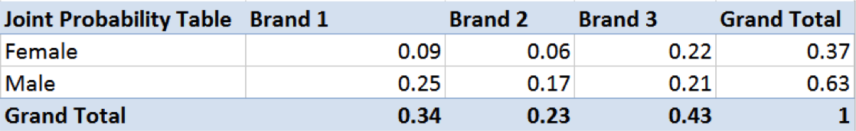
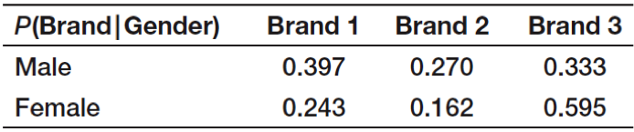
Example : Determining if Two Events are Independent
Are Gender and Brand Preference Independent?
P(B₁) = 0.34
P(B₁|M) = 0.397
Because 0.397 ≠ 0.34, Gender and Brand Preference are not independent.

Slide 95
BAYE’S THEOREM
Let S be the Sample Space and let E1, E2, …… , En be n mutually exclusive and exhaustive events associated with a random experiment. If A is any event which occurs with E1 or E2 or ….. or En.
Then,
P(E_{i}/A) =
P(A/E_{i}).P(E_{i})
n
∑ P(A/E_{i}).P(E_{i})
i=1

Slide 96
Example
A bag contains 4 red and 3 black balls. Second bag contains 2 red and 4 black balls. One bag is selected at random. From the selected bag, one ball is drawn. Find the probability that the ball drawn is of red colour.

Slide 97
Ans.
E₁ - bag 1 is selected
E₂ - bag 2 is selected
A - ball is of red colour
P(A) = P(A/E₁).P(E₁) + P(A/E₂).P(E₂)
= (4/7).(1/2) + (2/6).(1/2)
= 19/42

Slide 98
Example
In a test, an examinee either guesses or copies or knows the answer to a multiple choice with 4 choices, the probability that he makes a guess is 1/3 and the probability that he copies is 1/6. The probability that his answer is correct given that he copied it is 1/8. Find the probability that he knew the answer to the question given that he correctly answered it.

Slide 99
Ans.
E₁- examinee guesses the answer
E₂- examinee copies the answer
E₃- examinee knows the answer
A- answer is correct
P(E₃/A)=
=
= 24/29
P(A/E₃).P(E₃)
P(A/E₁).P(E₁) + P(A/E₂).P(E₂) + P(A/E₃).P(E₃)
1 . 1/2
1.1/2 + 1/4.1/3 + 1/8.1/6

Slide 100
Example
A manufacturing firm which receives shipment of the parts from two different suppliers. The historical quality levels of these two suppliers are shown in the following table :
Suppose supplier 1 supplies 70% of the parts and remaining 30% are supplied by the supplier 2. If a part is selected at random and found to be defective. What is the probability that it comes from first supplier?
 | Good Parts | Defective Parts
Supplier 1 | 95% | 5%
Supplier 2 | 90% | 10%

Slide 101
Ans.
P(S₁/D)=
P(S₁/D)=
= 7/13
= 0.53
P(D/S₂).P(S₂)
P(D/S₁).P(S₁) + P(D/S₂).P(S₂)
5/100. 70/100
5/100.70/100 + 30/100.10/100

Slide 102
Example
A laboratory blood test is 95% effective in detecting a certain disease HIV when it is, in fact, present. However the test also yield a false positive result for 1% of the healthy person tested( i.e. if healthy person is tested then with probability 0.01, the test result will imply that he has the disease ). If 0.5% of the population actually has HIV, what is the probability that a person has HIV given that his test result is positive.

Slide 103
Ans.
P(HIV/Positive)=
P(HIV/Positive)=
= 475/1470
= 0.323
P(Positive/HIV).P(HIV)
P(Positive/HIV).P(Defective) + P(Positive/HIV).P(No HIV)
95/100. (0.5/100)
95/100.(0.5/100) + 1/100.(995/100)

Slide 104
SPAM FILTERING/ FILTERING JUNK MAIL

Slide 105
P[ Spam / Words ] = P[ Words/Spam ]. P[ Spam ]
P[ Word ]

Slide 106
Considering the following information
P( Spam ) = 30% P( Not Spam ) = 70%
P[ Congratulations/ Spam ] = 75%
P[ Congratulations/ Not Spam ] = 35%

Slide 107
Now
P[ Spam/ Congratulations ] = ?
= P( Spam & Congratulations )
P( Congratulations )
= P( Congratulations/ Spam ).P( Spam )
P( Congratulations/ Spam ).P( Spam ) + P( Congratulations/ Not Spam ).P( Not Spam )
= 0.75 * 0.3
0.75*0.3 + 0.35*0.70
= 0.47

Slide 108
APPLICATION OF BAYE’S THEOREM

Slide 109
BAYE'S CLASSIFIER
DAYS | OUTLOOK | TEMPERATURE | HUMIDITY | WIND | PLAY(CRICKET)
1 | sunny | hot | high | weak | no
2 | sunny | hot | high | strong | no
3 | overcast | hot | high | weak | yes
4 | rain | mild | high | weak | yes
5 | rain | cool | normal | weak | yes
6 | rain | cool | normal | strong | no
7 | overcast | cool | normal | strong | yes
8 | sunny | mild | high | weak | no
9 | sunny | cool | normal | weak | yes
10 | rain | mild | normal | weak | yes
11 | sunny | mild | normal | strong | yes
12 | overcast | mild | high | strong | yes
13 | overcast | hot | normal | weak | yes
14 | rain | mild | high | strong | no
15 | sunny | cool | high | strong | ?
TO FIND:
TOTAL : 14 | PROBABILITY
YES : 9 | P(YES) = 9/14
NO :5 | P(NO) = 5/14

Slide 110
WIND

Slide 112
TEMPERATURE

Slide 114
let X ={Sunny,Cool,High,Strong}
P[YES|X]= P[YES]P[Sunny|YES]P[Cool|YES]P[High|YES]P[Strong|YES]
P[YES|X]= 9/14 x 2/9 x 3/9 x 3/9 x 3/9
P[X|NO]= P[NO]P[Sunny|NO]P[Cool|NO]P[High|NO]P[Strong|NO]
P[X|NO]= 5/14 x 3/5 x 1/5 x 4/5 x 3/5

Slide 115
THANK YOU

